Slide 1
Introduction to Embedded Systems

Slide 2
Pre-requisites
Pre-requisites
– 컴퓨터 구조
– UNIX/LINUX 프로그래밍 (preferred)
– 시스템프로그래밍 (preferred)
• Knowledge of C programming
– Need to know, understand and manipulate “pointers”
• Basic knowledge of digital logic
– Basic gates and their truth tables
• Assembly-language programming
– Knowledge of instruction sets of other modern microprocessors (x86, ARM, PowerPC, 680x0, MIPS) should be a sufficient and necessary starting point

Slide 3
Text books & references
Texts
  Handouts
  AND
  Steve Furber, ARM System-On-Chip Architecture
References
  John Catsoulis, Designing Embedded Hardware
  J. Corbet, A. Rubini, G. K.-Hartman, Linux Device Drivers
  ARM, ARM Architecture Reference Manual
  백승재, 최종무, 리눅스 커널 내부구조
  Datasheets

Slide 4
Homepage
http://cyber.incheon.ac.kr
교재, 슬라이드, data sheet 를 받을 수 있음
필요에 따라 보충 자료가 upload 될 것임
성적 게시도 이루어 짐

Slide 5
Grading
Lab projects: 30%
– Labs are individual assignments.
Midterm: 20%
  Announced later
Final: 30%
  Announced later
Attendance & attitude: 20%
  “F” for less than 70% attendance

Slide 6
Policies
Attendance
– (3 hours off = -1) & (5 weeks off ➔ F)
Cheating
– What is cheating?
• Sharing code: either by copying, retyping, looking at, or supplying a copy
of a file.
• Sharing homework or answers for test
– What is NOT cheating?
• Helping others use systems or tools or with high-level design issues
– Policy : 2 strikes out
• 1 strike → 0 for the lab/HW/test
• 2 strikes → F
10

Slide 7
Miscellaneous Lab Information
Odroid-C1
– Amlogic S805 1.5GHz Quadcore processor
- Mali-450 MP2 GPU 600MHz
- 1GB DDR3 SDRAM
You are responsible for your device.
  Each will be assigned a device.
Most labs might not be done in a class
  Build your development environment on your computer.
  You can bring your device home.

Slide 8
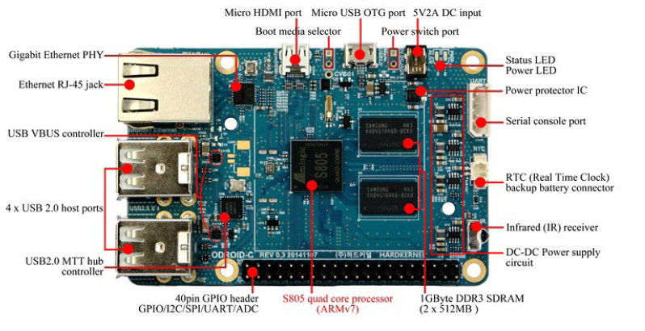
Odroid-C1

Slide 9
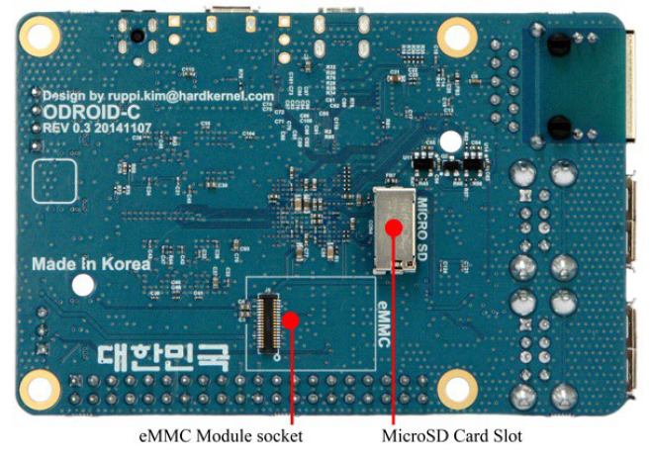
Board image

Slide 10
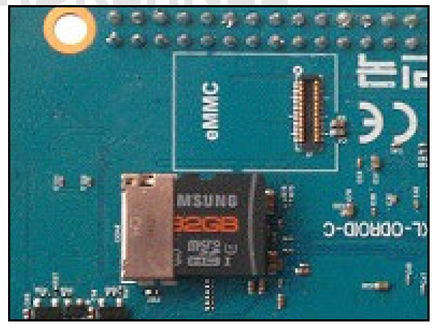
MicroSD
UHS-1 SD support
Boot device

Slide 11
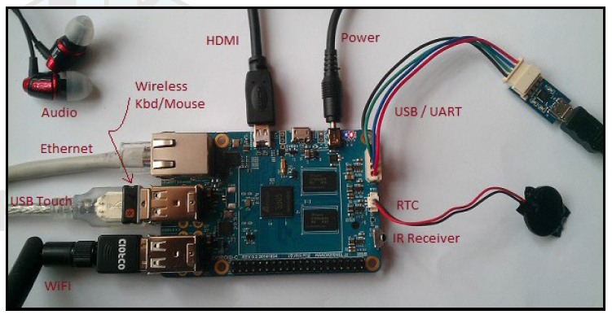
Peripherals

